Slide 1

Chapter-2
Role of Testing in SDLC

Slide 2

Role of Testing in SDLC
Testing plays an important role in all the phases in SDLC.
In the Development phase reviews will be held after completion of each module whether the module is built according the way they want (Verification)
In the testing phase after getting the build the testing is done to check whether the Build is developed according to the clients requirements (Validation)

Slide 3
Importance
Testing is important throughout the Software Development Life Cycle because:
1) it identifies and reports defects so they can be fixed
2) it helps key stakeholders understand the state of product or service quality so they can make informed business decisions
3) it helps improve the quality of products and services

Slide 4
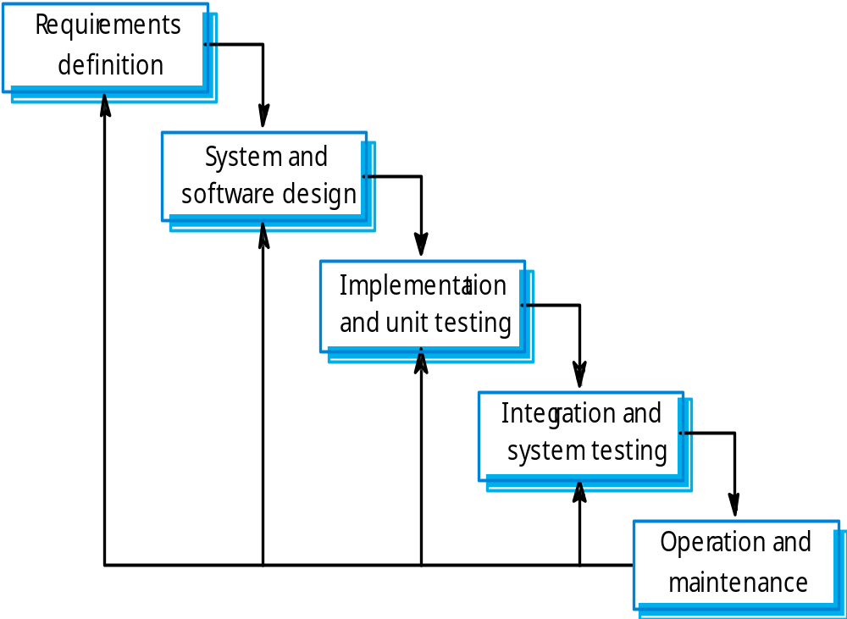
Waterfall model

Slide 5
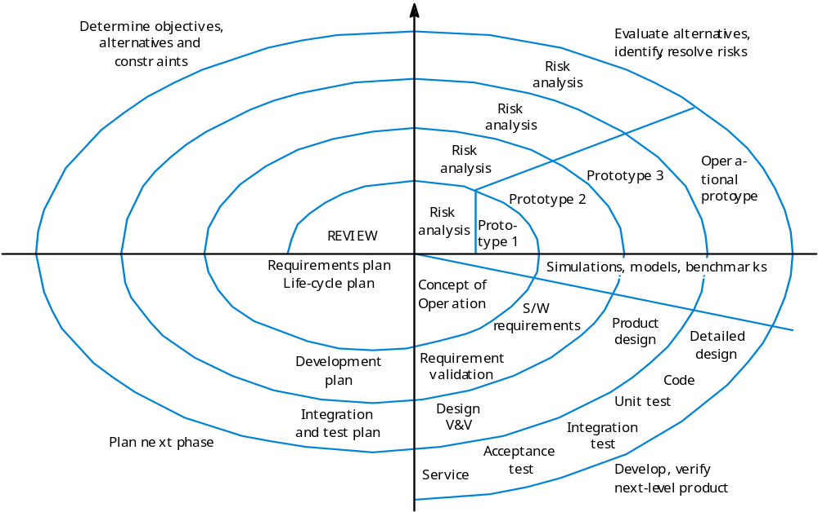
Spiral model of the software process

Slide 6
V-Model
The V-model promotes the idea that the dynamic test stages (on the right hand side of the model) use the documentation identified on the left hand side as baselines for testing.
The V-Model further promotes the notion of early test preparation.

Slide 7
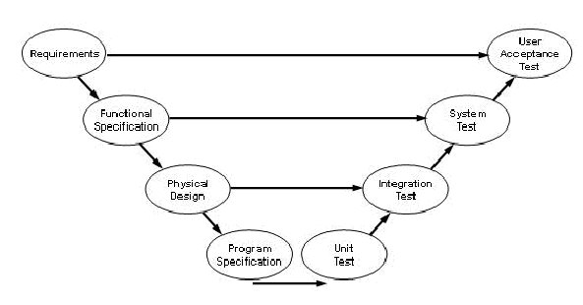
V-Model

Slide 8
V-Model
Early test preparation finds faults in baselines and is an effective way of detecting faults early.
This approach is fine in principle and the early test preparation approach is always effective.
However, there are two problems with the V-Model as normally presented.

Slide 9
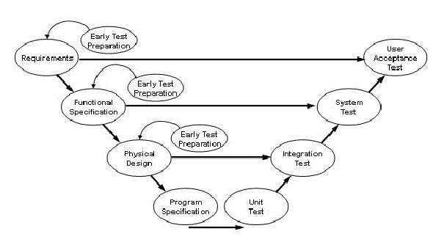
The V-Model with early test preparation

Slide 10
There is rarely a perfect, one-to-one relationship between the documents on the left hand side and the test activities on the right.
For example, functional specifications don’t usually provide enough information for a system test.
System tests must often take account of some aspects of the business requirements as well as physical design issues for example.
System testing usually draws on several sources of requirements information to be thoroughly planned.

Slide 11
V-Model has little to say about static testing at all. The V-Model treats testing as a back-door activity on the right hand side of the model.
There is no mention of the potentially greater value and effectiveness of static tests such as reviews, inspections, static code analysis and so on.
This is a major omission and the V-Model does not support the broader view of testing as a constantly prominent activity throughout the development lifecycle.

Slide 12
W Model
Paul Herzlich introduced the W-Model approach in 1993.
The W-Model attempts to address shortcomings in the V-Model. Rather than focus on specific dynamic test stages, as the V-Model does, the W-Model focuses on the development products themselves.
Essentially, every development activity that produces a work product is shadowed by a test activity.

Slide 13
The purpose of the test activity specifically is to determine whether the objectives of a development activity have been met and the deliverable meets its requirements.
In its most generic form, the W-Model presents a standard development lifecycle with every development stage mirrored by a test activity.

Slide 14
On the left hand side, typically, the deliverables of a development activity (for example, write requirements) is accompanied by a test activity the requirements and so on. If your organization has a different set of development stages, then the W-Model is easily adjusted to your situation.
The important thing is this: the W-Model of testing focuses specifically on the product risks of concern at the point where testing can be most effective

Slide 15
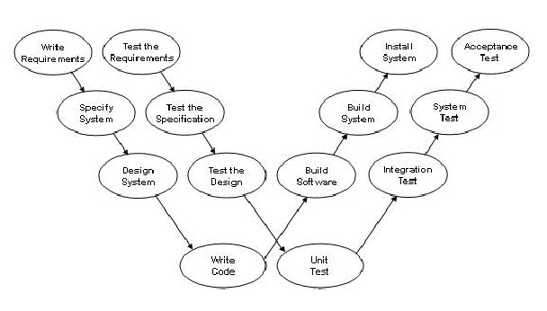
W Model

Slide 16
If we focus on the static test techniques, you can see that there is a wide range of techniques available for evaluating the products of the left hand side.
Inspections, reviews, walkthroughs, static analysis, requirements animation as well as early test case preparation can all be used.

Slide 17
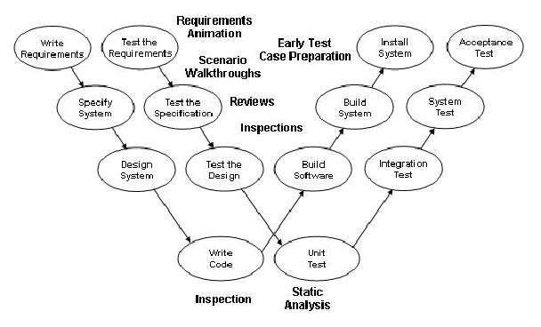
The W-Model & Static Test

Slide 18
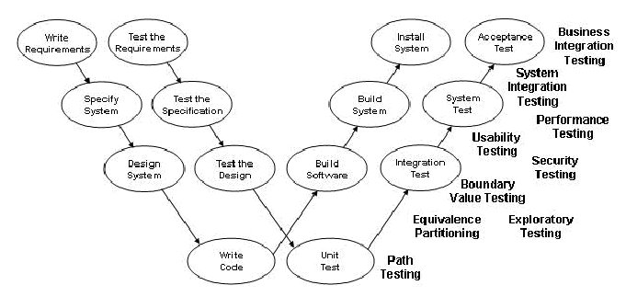
The W-Model and dynamic test techniques

Slide 19
The W-Model and dynamic test techniques.
If we consider the dynamic test techniques you can see that there is also a wide range of techniques available for evaluating executable software and systems.
The traditional unit, integration, system and acceptance tests can make use of the functional test design and measurement techniques as well as the non-functional test techniques that are all available for use to address specific test objectives.

Slide 20
The W-Model removes the rather artificial constraint of having the same number of dynamic test stages as development stages.
If there are five development stages concerned with the definition, design and construction of code in your project, it might be sensible to have only three stages of dynamic testing only.
Component, system and acceptance testing might fit your normal way of working.
The test objectives for the whole project would be distributed across three stages, not five.

Slide 21
There may be practical reasons for doing this and the decision is based on an evaluation of product risks and how best to address them.
The W-Model does not enforce a project symmetry that does not (or cannot) exist in reality.
The W-model does not impose any rule that later dynamic tests must be based on documents created in specific stages (although earlier documentation products are nearly always used as baselines for dynamic testing.

Slide 22
In projects using these methods, requirements and designs might be documented in multiple models so system testing might be based on several of these models (spread over several documents).
We use the W-Model in test strategy as follows. Having identified the specific risks of concern, we specify the products that need to be tested; we then select test techniques (static reviews or dynamic test stages) to be used on those products to address the risks; we then schedule test activities as close as practicable to the development activity that generated the products to be tested.

Slide 23
Advantages of the W-Model
In the W-model the importance of the tests and the ordering of the individual activities for testing are clear. Parallel to the development process, in a tighter sense, a further process - the test process - is carried out.
This is not first started after the development is complete.
The strict division between constructive tasks on the left-hand side and the more destructive tasks on the right-hand side that exists in the V-model is done away with.

Slide 24
In the W-model it is clear that such a division between tasks is not sensible and that a closer co-operation between development and testing activities must exist.
From the project outset onwards the testers and the developers are entrusted with tasks and are seen as an equal-rights partnership.
During the test phase, the developer is responsible for the removal of defects and the correction of the implementation.

Slide 25
The early collaboration and the tight co-operation between the two groups can often in practice avoid conflict meetings.
The W-model becomes closer to practice when the test expenditure is given 40% and more. The model clearly emphasizes the fact that testing is more than just construction, execution and evaluation of test cases.

Slide 26
Disadvantages of the W-Model
Models simplify the real facts. In practice there are more relations between the different parts of a development process.
However, there is a need for a simple model if all people involved in a project are to accept it.
This is also a reason why the simple V-model so frequently used in practice.
The models of software development presented do not clarify the expenditure needed for resources that need to be assigned to the individual activities.

Slide 27
Also in the W-model it appears that the different activities have an equal requirement for resources (time, personnel, etc.)
In practice this is certainly not the case. In each project the most important aspects may vary and so therefore the resource allocation is unlikely to be equal across activities.
For highly critical applications the test activities certainly have higher weighting or at least equal weighting with other activities.

Slide 28
Agile Methodology
What Is Agile?
Agile methodology is an approach to project management, typically used in software development.
It helps teams respond to the unpredictability of building software through incremental, iterative work cadences, known as sprints.
But before discussing agile methodologies further, it’s best to first turn to the methodology that inspired it: waterfall, or traditional sequential development

Slide 29
Why Agile?
Agile development methodology attempts to provide many opportunities to assess the direction of a project throughout the development lifecycle. This is achieved through regular cadences of work, known as sprints or iterations, at the end of which teams must present a shippable increment of work.
Thus by focusing on the repetition of abbreviated work cycles as well as the functional product they yield, agile methodology could be described as “iterative” and “incremental.”

Slide 30
Where Did Agile Come From?
In 1970, Dr. Winston Royce presented a paper entitled “Managing the Development of Large Software Systems,” which outlined his ideas on sequential development.
In essence, his presentation asserted that a project could be developed much like an automobile on an assembly line, in which each piece is added in sequential phases..

Slide 31
This means that every phase of the project must be completed before the next phase can begin.
Thus, developers first gather all of a project’s requirements, then complete all of its architecture and design, then write all of the code, and so on.
There is little, if any, communication between the specialized groups that complete each phase of work

Slide 32
It’s easy to see how this development agile methodology is far from optimized.
First of all, it assumes that every requirement of the project can be identified before any design or coding occurs.
Put another way, do you think you could tell a team of developers everything that needed to be in a piece of software before it was up and running? Or would it be easier to describe your vision to the team if you could react to functional software?

Slide 33
Many software developers have learned the answer to that question the hard way: At the end of a project, a team might have built the software it was asked to build, but, in the time it took to create, business realities have changed so dramatically that the product is irrelevant.
In that scenario, a company has spent time and money to create software that no one wants.
Couldn’t it have been possible to ensure the end product would still be relevant before it was actually finished?

Slide 34
Why Agile?
  Agile development methodology attempts to provide many opportunities to assess the direction of a project throughout the development lifecycle. This is achieved through regular cadences of work, known as sprints or iterations, at the end of which teams must present a shippable increment of work.

Slide 35
In an agile paradigm, every aspect of development — requirements, design, etc. — is continually revisited throughout the lifecycle.
When a team stops and re-evaluates the direction of a project every two weeks, there’s always time to steer it in another direction.

Slide 36
The results of this “inspect-and-adapt” approach to development greatly reduce both development costs and time to market.
Because teams can gather requirements at the same time they’re gathering requirements, the phenomenon known as “analysis paralysis” can’t really impede a team from making progress.
And because a team’s work cycle is limited to two weeks, it gives stakeholders recurring opportunities to calibrate releases for success in the real world.

Slide 37
In essence, it could be said that the agile development methodology helps companies build the right product. Instead of committing to market a piece of software that hasn’t even been written yet, agile empowers teams to optimize their release as it’s developed, to be as competitive as possible in the marketplace.
In the end, a development agile methodology that preserves a product’s critical market relevance and ensures a team’s work doesn’t wind up on a shelf, never released, is an attractive option for stakeholders and developers alike.

Slide 38
Instrumentation and Tool support
White box techniques require that different program fragments executes and conditions get different logical values .
In order to be able to evaluate the test, it must be determined which program fragments have already been executed and which fragments have not yet been executed.
For that purpose the test object must be instrumented at strategic relevant spots of the test execution.

Slide 39
Instrumentation often works this way:-
The tools inserts counters in the program and initializes them with zero.
During program execution, the counters are incremented when they are passed.
At the end of the test execution, the counters contain the number of passes through the according program fragments.
If a counter stayed at zero during the test, then the according program fragment has not been executed.

Slide 40
The instrumentation, the evaluation of the test runs, and the calculation of the achieved coverage should not be done manually.
Because this would require too many resources and the manual instrumentation is error prone.
Numerous tool perform these tasks, which are very important for white box testing because they increase the productivity and indirectly improve the quality of the test object.

Slide 41
Test Levels
Unit Testing
Component Testing
Module Testing
Integration Testing
System Testing
Acceptance Testing
Regression testing

Slide 42
Unit
The smallest compliable component. A unit typically is the work of one programmer (At least in principle). As defined, it does not include any called sub-components (for procedural languages) or communicating components in general.

Slide 43
Unit Testing
A unit is smallest testable piece of software
  can be compiled, linked, loaded
  e.g functions/procedures, classes, interfaces
  normally done by programmer
  Test cases written after coding
Disadvantage
  –Test cases -written to suit programmer’s implementation (not necessarily specification)
  Better to use “Buddy Testing”

Slide 44
Unit Testing
Unit testing is a software verification and validation method in which a programmer tests if individual units of source code are fit for use.
A unit is the smallest testable part of an application. In procedural programming a unit may be an individual function or procedure.

Slide 45
Component
A unit is a component. The integration of one or more components is a component.

Slide 46
Component Testing
The same as unit testing except that all stubs and simulators are replaced with the real thing.
Two components (actually one or more) are said to be integrated when:
  They have been compiled, linked, and loaded together.
  They have successfully passed the integration tests at the interface between them.
  Thus, components A and B are integrated to create a new, larger, component (A,B). Note that this does not conflict with the idea of incremental integration -- it just means that A is a big component and B, the component added, is a small one.

Slide 47
Main Attribute
s/w component are tested individually and isolated from all other s/w components of the system.
Isolation is necessary to prevent external influences on components.
Testing is done in close cooperation with development.

Slide 48
Objectives
To guarantee that the particular test object executes its entire functionality correctly and completely, as required by the specification.
Functionality – input/output behavior
Later, when the whole system is integrated, each s/w component must cooperate with many neighboring components

Slide 49
Conclusion
Component testing should check :
  functionality
  Robustness
  Component’s characteristics that have a crucial influence on its quality . This may include some non functional characteristics like efficiency and maintainability.
    Efficiency – how efficiently the component uses computer resource
    Maintainability – all characteristics of a program that have an influence on how easy or how difficult it is to change the program or to continue developing it.

Slide 50
Module Testing
Also known as unit or component testing phase, module testing is concerned with the testing of the smallest piece of software for which a separate specification exists.

Slide 51
Integration
Groups of components are supposed to form larger structural units and subsystems. This connecting of components are called integration.
It is done by developer, testers, or special integration teams.

Slide 52
Integration Testing
The goal of integration testing is to expose faults in the interfaces and in the interaction between integrated components.
Its task is to find collaboration and interoperability problems and isolate their causes.
Monitors- programs that read and log data traffic between components.

Slide 53
Integration Strategy
Top Down Integration : tests starts with the top level component of the system that calls other component but not calls itself
Bottom Up Integration : test starts with the elementary system component that do not call further components, except for function of the OS
Ad hoc Integration : components are being integrated in the order in which they are finished.
Backbone Integration Strategy : A skeleton or backbone is built into which components are gradually integrated.

Slide 54
System Testing
Test of overall interaction of components
Find disparities between implementation and specification
Usually where most resources go to
Involves – load, performance, reliability and security testing
To validate whether the complete system meets the specified functional and non functional requirements, and how well it does that

Slide 55
Who performs system testing and when is done?
  Done by the test team
  Test cases written when high level design spec is ready
Where is it done?
  Done on a system test machine
Usually in a simulated environment e.g. vmware

Slide 56
Acceptance Testing
Demonstrates satisfaction of user
Users are essential part of process
Usually merged with System Testing
Done by test team and customer
Done in simulated environment/real environment

Slide 57
Forms of Acceptance Testing
Testing to determine whether contract have been met
  Test criteria are determined in development contract
User acceptance testing
  Done if the customer & user are different individuals
Operational (acceptance) testing
  Assures the acceptance of system by system administrators. Include testing of backup/restore cycles, disaster recovery, user management, maintenance tasks, and check of security vulnerabilities.
Field test (alpha & beta testing)
  To identify influences from users environments that are not entirely known or that are not specified, and to eliminate them of necessary.
  If the software is supposed to run in more than one operational environment.

Slide 58
Generic Types of Testing
Functional Testing
  Verify a system’s input output behavior
  Describe “what” a system must be able to do
Nonfunctional Testing
  Describe the attributes of the system as a whole
  “how well” or with what quality the system should carry out its functions
Testing of Software Structure
  Use information about test object’s internal code structure architecture
Testing Related to Changes
  When existing s/w is changed, defects are repaired, or new parts are added, the changed part must be Retested

